Slide 1

TCPro: a novel model describing the ex vivo immune response to therapeutic proteins and its use for assigning immunogenicity risk
Osman N Yogurtcu
Analytics in Benefit-Risk Assessment Team
US FDA/CBER/Office of Biostatistics and Epidemiology
12th European Immunogenicity Platform Open Symposium, March 3rd, 2021
Notes:
Thank you and Hello from Washington DC.
My name is Osman Yogurtcu and I am hoping I will be able to convince you today to rethink about the potential of in silico tools in immunogenicity risk assessment.

Slide 2
Disclosure Slide
I have no relevant financial relationships to disclose for this session.
My comments and contributions are an informal communication and represent my own best judgment. These comments do not bind or obligate FDA.
Notes:
Here are my disclosures.

Slide 3

Unwanted Immunogenicity: a Serious Problem
Efficacy:
Anti-drug antibodies (ADAs) may or may not affect the activity of the drug.
Antibodies that impede drug activity by binding to active protein domains are called neutralizing ADAs (NAbs).
Non-neutralizing antibodies are not necessarily benign as they can affect the PK/PD profile and cause loss of tissue targeting. [Mahlangu et al. 2015 JTH]
Safety:
ADAs can also cross-react with endogenous proteins or elicit anaphylactic reactions. [Krishna & Nadler 2016 Front. Immun.]
Slide adapted from Dr. Zuben Sauna, FDA/CBER/OTAT
Notes:
Immunogenicity is defined as the propensity of the therapeutic protein product to generate immune responses to itself and to related proteins or to induce immunologically related adverse clinical events.
Unwanted immunogenicity is a serious efficacy and safety problem.

Slide 4
Early and Accurate Assessment of Immunogenicity Risk is Important
“Given the variety of factors that can affect immunogenicity, the risk assessment and the control and mitigation strategies will depend on the individual development program and should be considered at the earliest stage and at each subsequent stage of product development.”
“In addition to appropriate animal studies, consideration should be given to in vitro and in silico analyses that may supplement animal studies to better or further elucidate risk for immunogenicity.”
Slide adapted from Paul Chamberlain’s presentation at the last year’s EIP Symposium
FDA’s Guidance on Immunogenicity Assessment for Therapeutic Protein Products: https://www.fda.gov/media/85017/download
Notes:
Early and Accurate Assessment of Immunogenicity Risk is Important
To quote FDA’s Guidance on Immunogenicity assessment….
And about immunogenicity assessment methods

Slide 5





Immunogenicity Assessment: The Methods
in vivo
ex vivo
in silico
Time
Money
Limited sample size
Direct measurement
Jawa, Vibha, et al. "T-cell dependent immunogenicity of protein therapeutics pre-clinical assessment and mitigation–updated consensus and review 2020." Frontiers in Immunology 11 (2020).
Notes:
Let’s take a look at some of the key methods at our disposal.
First, in vivo (or clinical) immunogenicity assessment takes the longest time as patients or healthy volunteers need to be recruited and followed up for a long time. This and other associated factors make in vivo assessments very costly. Also, there is a limit to the number of people we can recruit for the clinical trials and the observational studies. However, in vivo studies provide us the most direct measurement of immunogenicity.
Second, ex vivo studies take less time and are less costly. They allow for a larger sample size, but all that comes at the cost of performing an indirect measurement.
Lastly, in silico methods take the least amount of time. They are absolutely not cost-prohibitive. We can simulate as many virtual patients as we wish, but they provide the most indirect measurement of immunogenicity.
Wouldn’t it be nice to have a very economic, quick, and flexible method that assess immunogenicity as accurate as in the clinic?
… MAPPS is resource-consuming and costly (Jawa et al., 2020).
… in vitro assays may be cost-prohibitive (Jawa et al., 2020)

Slide 6
Can we develop a software that successfully reproduces ex vivo assays in silico?
ex vivo
in silico
TCPro
Notes:
OR, here’s another question. Can we develop a software that successfully reproduces ex vivo assays in silico?
Because if we can, this would be a rapid flexible and inexpensive initial screen for immunogenicity risk.
And our TCPro tool aims to do this.

Slide 7
MY KEY MESSAGES
1. We developed TCPro to assess a protein-drug’s potential of causing immunogenicity in patient populations.
2. TCPro was validated with data from ex vivo assays performed on different drug samples.
3. Our immunogenicity risk predictions for various protein-drugs generally agreed well with experimental and clinical observations.
4. We predicted insignificant immunogenicity risk difference between patient cohorts from different ethno-geographical backgrounds.
Notes:
Alright, so before I go ahead and bore you with details, let me start with my key messages for you for today.

Slide 8
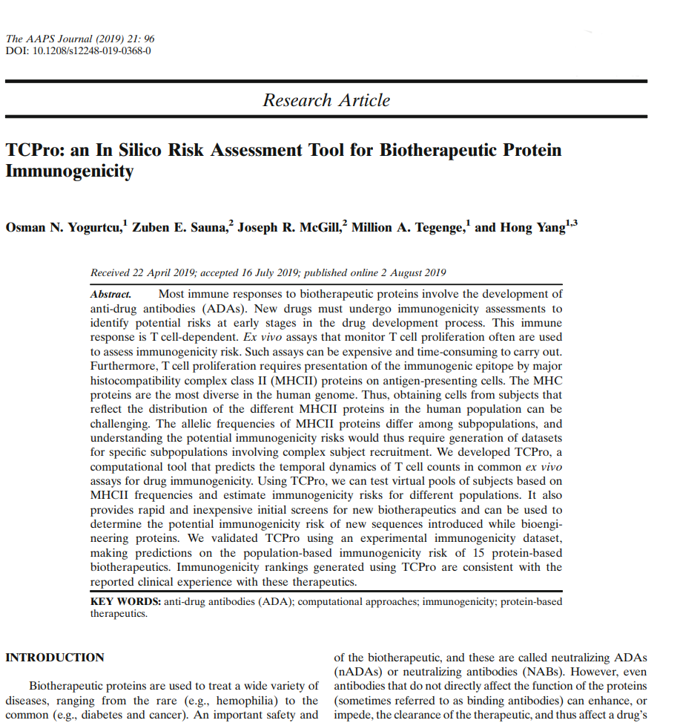
The TCPro Team
Hong Yang
Office of Biostatistics and Epidemiology (OBE), CBER
Zuben E. Sauna,
Million A. Tegenge,
Joseph R. McGill
Office of Tissues and Advanced Therapies (OTAT), CBER
Yogurtcu ON et al. TCPro: an In Silico Risk Assessment Tool for Biotherapeutic Protein Immunogenicity. The AAPS journal. 2019 Sep 1;21(5):96.
Notes:
So, about four years ago, we formed a team of researchers from FDA’s CBER office of biostatistics and Epidemiology (OBE) and Office of tissues and advanced therapies (OTAT) with the aim of better understanding the interplay between the human immune system and biotherapeutics using mechanistic/mathematical/statistical modeling approaches with a particular focus in rare diseases. And TCPro is one of the fruits of this collaboration and I would like to thank Doctors Hong Yang, Million Tegenge, Zuben Sauna and Joe McGill.

Slide 9
What is TCPro?
A computational tool that
uses immunogenetic information of large patient cohorts,
simulates CD8⁺ cell-depleted ex vivo time course T cell assays,
evaluates product immunogenicity risk.
TCPro simulates thymidine incorporation and ELISpot assays in parallel.
TCPro calculates %cohort responding to a product.
The response is measured by Stimulation Index:
Strength of product-influenced T cell response relative to baseline (i.e. no-drug) response

Slide 10
TCPro needs three inputs
Amino acid sequence of the product of interest
Immunogenomic information of the cohort
A list of cohort-member HLA-DRB1 alleles
Distribution of product-specific T cell frequency
data from in-house ex vivo or in vitro experiments
data from the literature

